Slide 1
Blockchain & Business Application
Lecture 2:
Introduction to Cryptography
Most of these slides are from:
Harvard Professor Boaz Barak’s
«COS 43 Cryptography» Lecture Notes at Princeton
This part covers only «Classical Cryptography»
But we will later discuss the threat by quantum computers,
and the idea of «Quantum Cryptography»
as well as «Quantum Blockchain»

Slide 2
Cryptography
History of 2500- 4000 years.
Throughout most of this history:
cryptography = “secret writing”:
“Scramble” (encrypt) text such that it is hopefully unreadable by anyone except the intended receiver that can decrypt it.
Recurring theme: (until 1970’s)
Secret code invented
Typically claimed “unbreakable” by inventor
Used by spies, ambassadors, kings, generals for crucial tasks.
Broken by enemy using cryptanalysis.
“Human ingenuity cannot concoct a cipher
which human ingenuity cannot resolve.”
Edgar Alan Poe, 1841

Slide 3
Crypto History
1587: Ciphers from Mary of Scots plotting assassination of queen Elizabeth broken; used as evidence to convict her of treason.
1860’s (civil war): Confederacy used good cipher (Vigenere) in a bad way. Messages routinely broken by team of young union cryptanalysts; in particular leading to a Manhattan manufacturer of plates for printing rebel currency.
1878: New York Tribune decodes telegram proving Democrats’ attempt to buy an electoral vote in presidential election for $10K.
1914: With aid of partial info from sunken German ships, British intelligence broke all German codes. Cracked telegram of German plan to form alliance with Mexico and conquer back territory from U.S. As a result, U.S. joined WWI.
WWII: Cryptanalysis used by both sides. Polish & British cryptanalysts break supposedly unbreakable Enigma cipher using mix of ingenuity, German negligence, and mechanical computation. Churchill credits cryptanalysts with winning the war.

Slide 4
Crypto History
1976: Diffie and Hellman propose new, more ambitious, notion of “public key cryptography” based on simple to state, hard to solve, computational problem.
“We stand today on the brink of a revolution in cryptography”
1977: Rivest, Shamir and Adleman (RSA) propose another public key crypto candidate.
1977-: Schemes stay unbroken despite attacks with unprecedented manpower and computer cycles.
1980’s-: Web of reductions – even more ambitious notions: CCA secure encryption, CMA secure signatures, zero knowledge, electronic cash, electronic elections and auctions, privacy preserving data mining, …. , fully homomorphic encryption (2009).
Today: Breaking cryptography not considered top cyber security threat.

Slide 5

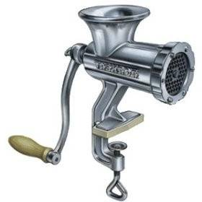
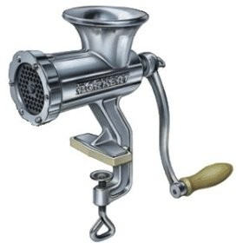
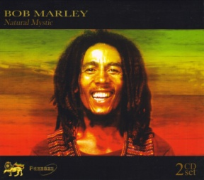
Encryption Schemes
Alice wants to send Bob a secret message.
m:
AMEX 1234567890
m’ = D(c)
AMEX 1234567890
k
k
ASJGKJQEIREWIYU
c = E(m)
They agree in advance on 3 components:
Encryption algorithm: E
Decryption algorithm: D
Secret key: k
To encrypt plaintext m, Alice sends c = E(m,k) to Bob.
To decrypt a cyphertext c, Bob computes m’ = D(c,k).
A scheme is valid if m’=m
Intuitively, a scheme is secure if eavesdropper can not learn m from c.

Slide 6
Example 1: Caesar’s Cipher
Key: k = no. between 0 and 25.
Encryption: encode the i^{th} letter as the (i+k) ^{th} letter.
(working mod 26: z+1=a )
Decryption: decode the j^{th} letter to the (j-k) ^{th} letter.
Plain-text:
S E N D R E I N F O R C E M E N T
Key: 2
Cipher-text:
U G P F T F K P H Q T E G O G P V
Problem: only 26 possibilities for key – can be broken in short time.
Kerchoff’s Principle (1883): System should be secure even if algorithms are known, as long as key is secret.
In other words: “security through obscurity” does not work.

Slide 7
Example 2: Substitution Cipher
Key: k = table mapping each letter to another letter
A
B
C
Z
U
R
B
E
Encryption and decryption: letter by letter according to table.
# of possible keys: 26!
( = 403,291,461,126,605,635,584,000,000 )
However – substitution cipher is still insecure!
Key observation: can recover plaintext using statistics on letter frequencies.
Here e r e h e t t r r ht
ethe eet e r e h h t e e t e
HereUpOnLeGrandAroseWithAGraveAndStatelyAirAndBrought
MeTheBeetleFromAGlassCaseInWhichItWasEnclosedItWasABe
He e e e h e t t ht
ethe eet e e h h t e e t e
Here e ra a e ha a ea tat a ra r ht
ethe eet e r a a e h h t a e e t a a e
LIVITCSWPIYVEWHEVSRIQMXLEYVEOIEWHRXEXIPFEMVEWHKVSTYLX
ZIXLIKIIXPIJVSZEYPERRGERIMWQLMGLMXQERIWGPSRIHMXQEREKI
I – most common letter
I=e L=h X=t
LI – most common pair
V=r E=a Y=g
XLI – most common triple

Slide 8
Example 3- Vigenere
(Belaso, 1553)
“Multi-Caesar Cipher” – A stateful cipher
Key: k = (k₁,k₂,…,k_{m}) list of m numbers between 0 and 25
Encryption:
1st letter encoded as Caesar w/ key=k₁ : i → i + k₁ (mod 26)
n^{th} letter encoded w/ key=k_{(n mod m)} : i → i + k_{(n mod m)} (mod 26)
Decryption: In the natural way
2nd letter encoded as Caesar w/ key=k₂ : i → i + k₂ (mod 26)
…
Important Property: Can no longer break using letter frequencies alone.
m^{th} letter encoded as Caesar w/ key=k_{m} : i → i + k_{m} (mod 26)
‘e’ will be mapped to ‘e’+k₁,‘e’+k₂,…,‘e’+k_{m} according to location.
m+1th letter encoded as Caesar w/ key=k₁ : i → i + k₁ (mod 26)
Considered “unbreakable” for 300 years (broken by Babbage, Kasiski 1850’s)

Slide 9
Example 3- Vigenere
(Belaso, 1553)
“Multi-Caesar Cipher” – A stateful cipher
Key: k = (k₁,k₂,…,k_{m}) list of m numbers between 0 and 25
Encryption:
n^{th} letter encoded w/ key=k_{(n mod m)} : i → I + k_{(n mod m)} (mod 26)
Decryption: In the natural way
Breaking Vigenere:
LIVITC
SWPIYV
EWHEVS
RIQMXL
EYVEOI
EWHRXE
XIPFEM
VEWHKV
Step 1: Guess the length of the key m
Step 2: Group together positions {1, m+1, 2m+1, 3m+1,…}
{2, m+2, 2m+2, 3m+2,…}
…
{m-1, 2m+m-1, 3m+m-1,…}

Slide 10
Example 3- Vigenere
(Belaso, 1553)
“Multi-Caesar Cipher” – A stateful cipher
Key: k = (k₁,k₂,…,k_{m}) list of m numbers between 0 and 25
Encryption:
n^{th} letter encoded w/ key=k_{(n mod m)} : i → i + k_{(n mod m)} (mod 26)
Decryption: In the natural way
Breaking Vigenere:
LIVITC
SWPIYV
EWHEVS
Step 1: Guess the length of the key m
RIQMXL
EYVEOI
Step 2: Group together positions 1, m+1, 2m+1, 3m+1,…
EWHRXE
XIPFEM
{2, m+2, 2m+2, 3m+2,…}
VEWHKV
…
{m-1, 2m+m-1, 3m+m-1,…}
Step 3: Frequency-analyze each group independently.

Slide 11
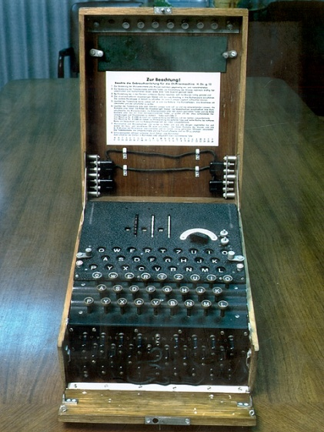
Example 4 - The Enigma
A mechanical stateful cipher.
Used by Germany in WWII for top-secret communication.
Roughly: composition of 3-5 substitution ciphers implemented by wiring.
Wiring on rotors moving in different schedules, making cipher stateful
Key:
1) Wiring of machine (changed infrequently)
2) Daily key from code books
3) New operator-chosen key for each message
Tools used by Poles & British to break Enigma:
1) Mathematical analysis combined w/ mechanical computers
2) Captured machines and code-books
3) German operators negligence
4) Known plaintext attacks (greetings, weather reports)
5) Chosen plaintext attacks

Slide 12
Post 1970’s Crypto
Two major developments:
1) Provably secure cryptography
Encryptions w/ mathematical proof that are unbreakable*
* Currently use conjectures/axioms,
however defeated all cryptanalysis effort so far.
2) Cryptography beyond “secret writing”
Public-key encryptions
Digital signatures
Zero-knowledge proofs
Anonymous electronic elections
Privacy-preserving data mining
e-cash
…

Slide 13


Review of Encryption Schemes
Alice wants to send Bob a secret message.
c
c = E(m,k)
m’ = D(c,k)
Encryption algorithm: E
Decryption algorithm: D
Secret key: k
To encrypt m, Alice sends c = E(m,k) to Bob.
To decrypt c, Bob computes m’ = D(c,k).
Q: Can Bob send Alice the secret key over the net?
A: Of course not!! Eve could decrypt c!
Q: What if Bob could send Alice a “crippled key”
useful only for encryption but no help for decryption

Slide 14
Public Key Cryptography [DH76,RSA77]
Alice wants to send Bob a secret message.
e
c
choose d,e
c = E(m,e)
m’ = D(c,d)
Encryption algorithm: E
Decryption algorithm: D
Key: Bob chooses two keys:
Secret key d for decrypting messages.
Public key e for encrypting messages.
To encrypt m, Alice sends c = E(m,e) to Bob.
Even if Eve knows the key e!
Should be safe to send e “in the clear”!
To decrypt c, Bob computes m’ = D(c,d).
A scheme is valid if m’=m
Intuitively, a scheme is secure if eavesdropper can not learn m from c.

Slide 15
Other Crypto Wonders
Digital Signatures. Electronically sign documents in unforgeable way.
Zero-knowledge proofs. Alice proves to Bob that she earns <$50K without Bob learning her income.
Privacy-preserving data mining. Bob holds DB. Alice gets answer to one query, without Bob knowing what she asked.
Playing poker over the net. Alice, Bob, Carol and David can play poker over the net without trusting each other or any central server.
Distributed systems. Distribute sensitive data to 7 servers s.t. as long as <3 are broken, no harm to security occurs.
Electronic auctions. Can run auctions s.t. no one (even not seller) learns anything other than winning party and bid.
Fully homomorphic encryption. Encrypt E(m) in a way that allows anyone to compute E(f(m)) for every function f.

Slide 16
Cryptography & Security
Prev slides: Have provably secure algorithm for every crypto task imaginable.
Q: How come nothing is secure?
A1: Not all of these are used or used correctly:
Strange tendency to use “home-brewed” cryptosystems.
Combining secure primitives in insecure way
Misunderstanding properties of crypto components.
Strict efficiency requirements for crypto/security:
The cost is visible but benefit invisible.
Many provably secure algs not efficient enough
Easy to get implementation wrong – many subtleties
Compatibility issues, legacy systems,

Slide 17
Public-Key Algorithms
Encryption in which each party publishes a public part of their key and keep secret a private part of it
RSA (by Rivest, Shamir, Adleman) »

Slide 18
Public-Key Algorithms (1)
Downsides of keys for symmetric-key designs:
Key must be secret, yet be distributed to both parties
For N users there are N² pairwise keys to manage
Public key schemes split the key into public and private parts that are mathematically related:
Private part is not distributed; easy to keep secret
Only one public key per user needs to be managed
Security depends on the chosen mathematical property
Much slower than symmetric-key, e.g., 1000X
So use it to set up per-session symmetric keys

Slide 19
RSA (1)
RSA is a widely used public-key encryption method whose security is based on the difficulty of factoring large numbers
Key generation:
Choose two large primes, p and q
Compute n = p × q and z = ( p − 1) × (q − 1).
Choose d to be relatively prime to z
Find e such that e × d = 1 mod z
Public key is (e, n), and private key is (d, n)
Encryption (of k bit message, for numbers up to n):
Cipher = Plain^{e} (mod n)
Decryption:
Plain = Cipher^{d} (mod n)

Slide 20
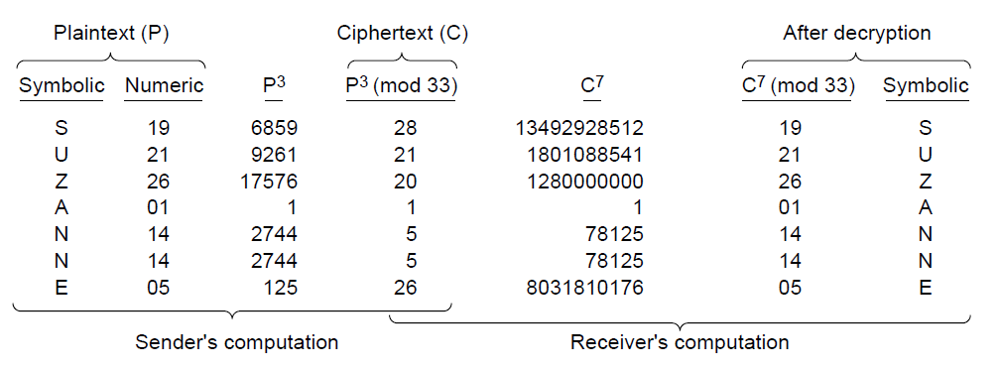
RSA (2)
Small-scale example of RSA encryption
For p=3, q=11 → n=33, z=20 → d=7, e=3
Encryption: C = P³ mod 33
Decryption: P = C⁷ mod 33

Slide 21
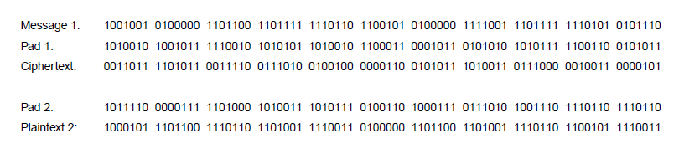
One-Time Pads (1)
Simple scheme for perfect secrecy:
XOR message with secret pad to encrypt, decrypt
Pad is as long as the message and can’t be reused!
It is a “one-time” pad to guarantee secrecy
Different secret pad decrypts to the wrong plaintext

Slide 22
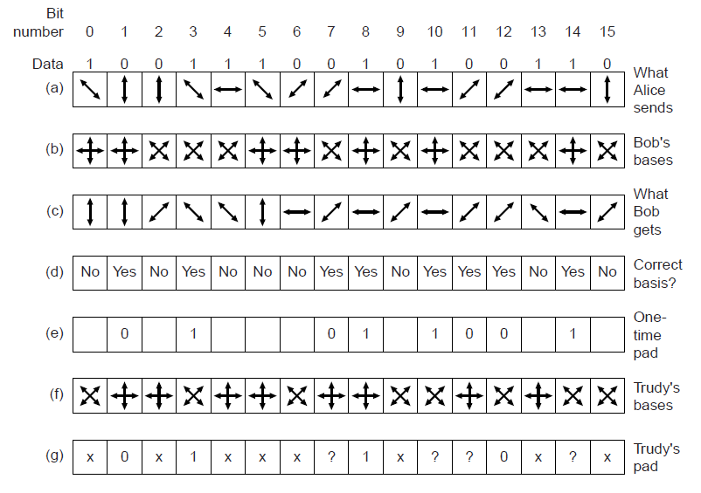
One-Time Pads (2)
Alice sending Bob a one-time pad with quantum crypto.
Bob’s guesses yield bits; Trudy misses some
Bob can detect Trudy since error rate increases

